Slide 1
Implementing Ant colony optimization in python- solving Traveling salesman problem
By- Darshana Rajput (U76679249)
Shradhanjali Pradhan (U09839092)

Slide 2
Introduction
The Depth First Search (DFS) Maze Solving Program, developed by Charles Pierre Tremaux, demonstrates the power of Python in maze navigation.
Objective: To apply DFS, a fundamental algorithm in graph theory, to solve maze configurations efficiently.
Turtle graphics visualizes the maze construction and solving process.

Slide 3
Implementation
Code Structure: "The program is structured in a modular and organized manner, divided into classes:“
Maze Class: Draws the maze layout using Turtle graphics, representing walls as white squares.
Green Class: Represents visited cells during exploration.
Blue Class: Indicates frontier cells being considered for exploration.
Red Class: Marks the starting point.
Yellow Class: Marks the endpoint and solution path.

Slide 4
Maze Representation
Construction: The maze is represented as a grid of characters, each representing specific elements such as walls, paths, start ('s'), and endpoint ('e').
Grid Method: "Rows and columns divide the maze into layers, with characters encoding elements:
'+' for walls,
' ' for paths,
's' for start,
'e' for endpoint."

Slide 5
Algorithm
Step-by-Step:
Initialization: Sets the starting point and begins exploration.
Exploration: Traverses in a specific order, adding valid paths to the frontier.
Backtracking: Returns to previous cells when encountering dead-ends, exploring alternative routes.
Solution Path: Reconstructs the route from the endpoint to the start, marking it visually.

Slide 6
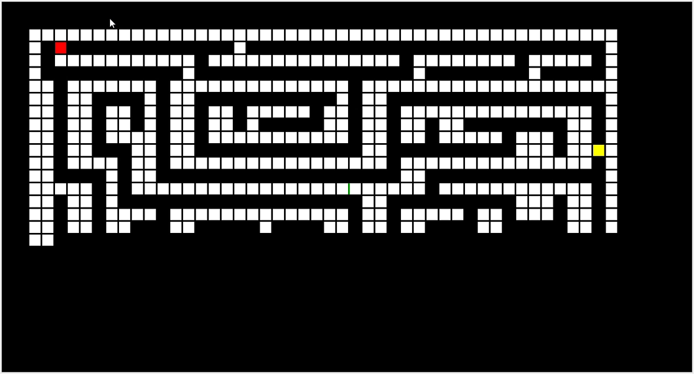

Slide 7
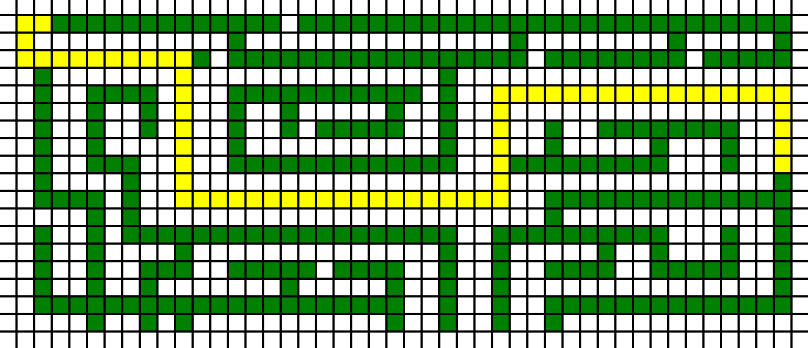
Results
Visualization: The maze-solving process is visualized dynamically using Turtle graphics.
Demonstration: The solution path is shown in yellow, marking the optimal route from start to endpoint.

Slide 8
Conclusion
The program demonstrates the effectiveness of DFS in maze-solving, exploring the maze, backtracking, and finding the solution path.
Python and graph traversal algorithms offer powerful solutions to complex computational challenges.

Slide 9
Thank You

